Slide 1
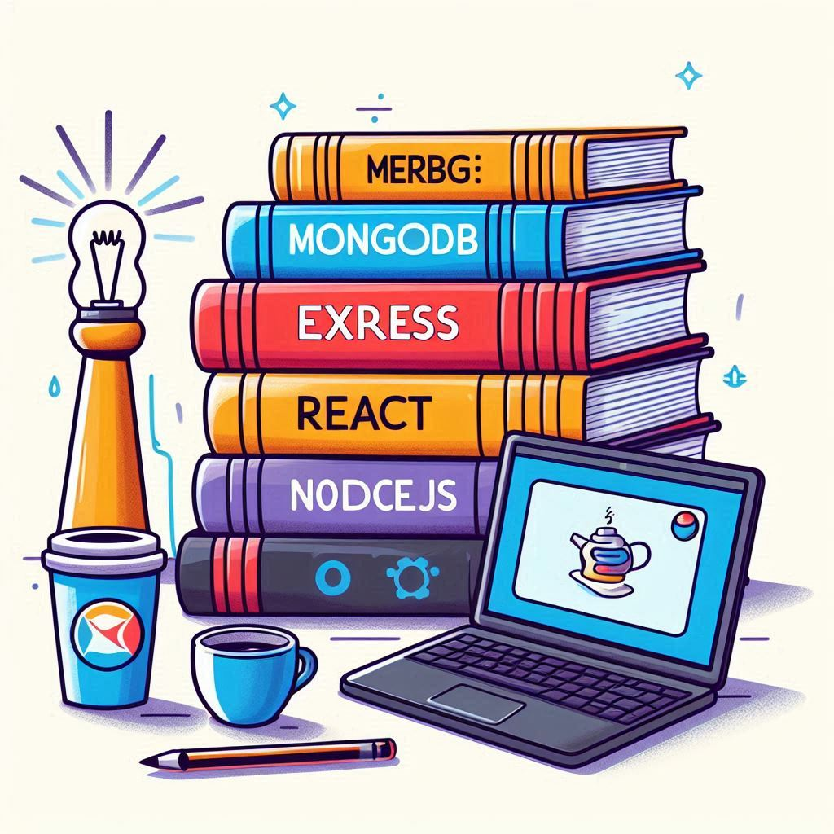
Grocery Web Application
NM – 1042 MERN Stack By Mongo DB

Slide 2

OBJECTIVE OF THE PROJECT
The main objectives of this project are:
Streamline Online Shopping
Efficient Product Management
Centralized Shopping Space
Real Time Updates
5) Efficient Payment Gateway

Slide 3

PREREQUISITES OF THE PROJECT
The prerequisites of the project are:
Frontend
Backend
Database Management
API’s
GIT

Slide 4
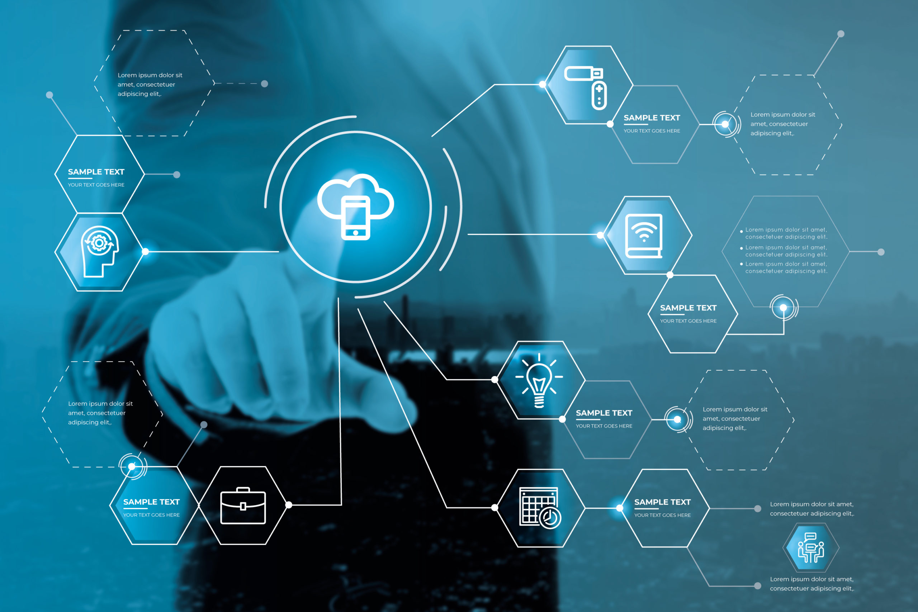
CORE TECHNOLOGIES USED
The core technologies used in the project are:
Node.js
Express.js
React.js
Mongo DB
Cloudinary
JSON Web Token (JWT)

Slide 5

FEATURES OF THE PROJECT
The features of the following project are:
User Management
Product Management
Shopping Cart
Wishlist
Checkout and Payment
Reviews and Ratings

Slide 6
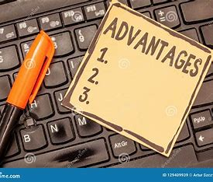
ADVANTAGES OF THE PROJECT
The advantages of the project are :
User Experience
Search and Filter option
Convenience
Real Time Updates
Secure Payment Gateway

Slide 7

CHALLENGES OF THE PROJECT
The challenges faced in this project are :
Backend Optimization
Database Design and Management
Testing and Debugging
User Role Management

Slide 8
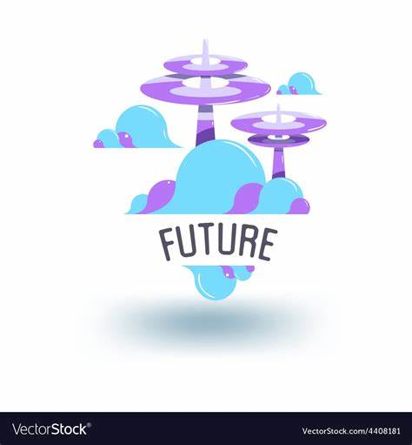
FUTURE ENHANCEMENTS
The project can be developed furthermore and can be made more usable:
Mobile Compatibility
Advanced Filtering
Payment Integration
In App Chat
Machine Learning Recommendations

Slide 9

PRESENTERS AND MENTOR
Presenters:
Bharanidharan
Delli Ganesh
Divayanshu Tiwari
Yogesh Kumaran
Mentor:
Mrs. Lakshmi Prabha

Slide 10

CONCLUSION:
* EKO-MART successfully bridges the gap between customers and vendors, offering a
seamless platform for product listing, browsing, and purchasing.
* By leveraging the
MERN stack, the application ensures high performance, scalability, and user-friendly
interactions.
* With features like secure authentication, real-time updates, and role-based
access control, the app provides a robust and secure environment for both users and
admins.
* Overall, EKO-MART is a successful implementation that lays the groundwork for future innovation in e-commerce services.

